Slide 1
Lecture 8 - VLANs
COMP1002 (Cybersecurity and Networks)

Slide 2
Overview
Virtual LANs (VLANs) (CCNA2/ch3)
Definition, benefits, types, tagging
Configuration
Trunking concepts, issues, attacks
InterVLAN routing (CCNA2/ch4)
Concept and configuration

Slide 3
Virtual LANs (VLANs)

Slide 4
Objectives
Purpose and benefits of VLANs
Functionality of VLANs
Configure
VLAN port assignment
Trunking
Dynamic Trunking Protocol (DTP)
Troubleshoot VLAN and trunk configuration
Configure security features

Slide 5
VLAN definition
A VLAN is a logical group of network stations and devices.
Important feature of Ethernet switching
Aim of VLANs - provide logical grouping for different users regardless of their physical location.
Each VLAN – separate logical network
Packets for other VLANs must be forwarded through a routing device
Each VLAN is a separate broadcasting domain
e.g. grouping different departments
Marketing department users – Marketing VLAN
Engineering department users – Engineering VLAN
...even though they may be in the same office.
Why?
Access to resources
Security
Improved data flow

Slide 6
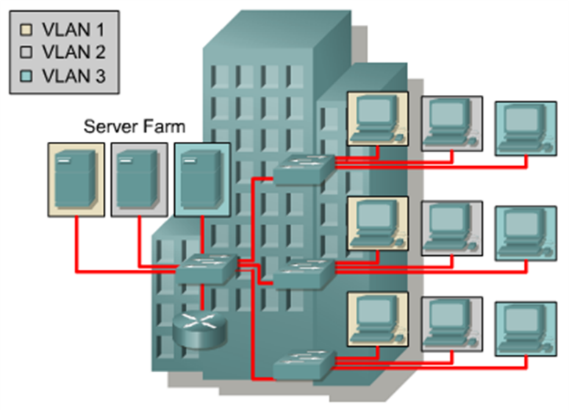
Logical versus Physical Topology
Three broadcast domains using switches and VLANs.
Members of same VLAN may be remote to each other.
The VLAN server can be located in a server farm.
Result: increased overall network performance by logically grouping users and resources together.

Slide 7
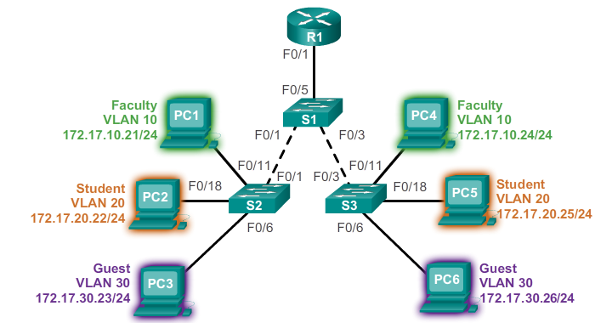
VLAN benefits
Security - Groups that have sensitive data are separated from the rest of the network, decreasing the chances of confidential information breaches.
Cost reduction - reduced need for upgrades, efficient use of bandwidth/uplinks.
Better performance - reduce unnecessary traffic on the network
Shrink broadcast domains - Dividing a network into VLANs reduces the number of devices in the broadcast domain.
Improved IT staff efficiency - easier to manage the network because users with similar network requirements share the same VLAN.
Simpler project and application management - VLANs aggregate users and network devices to support business or geographic requirements.

Slide 8
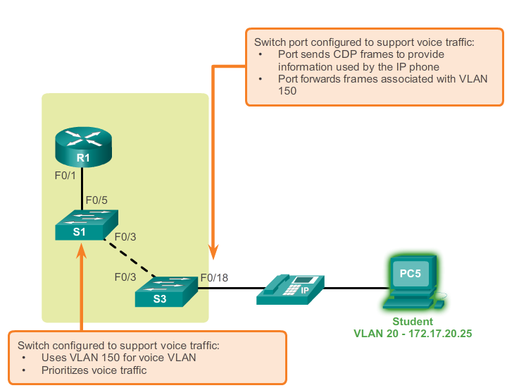
VLAN types
Data
User generated traffic
Voice
For IP telephony
Default
VLAN1
All ports allocated to it by default
Native
In relation to a trunk port
Carries untagged traffic
Management
Used to manage the switch (SVI)
VLAN1 by default

Slide 9
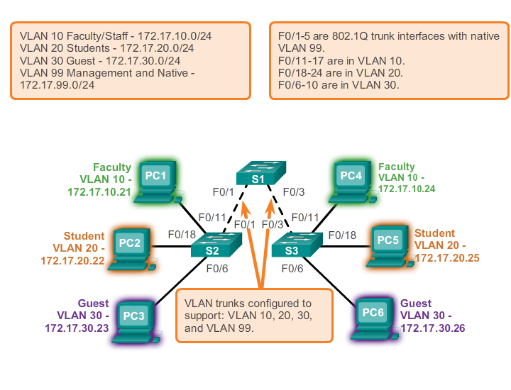
VLAN trunks
point-to-point link between two network devices that carries more than one VLAN

Slide 10
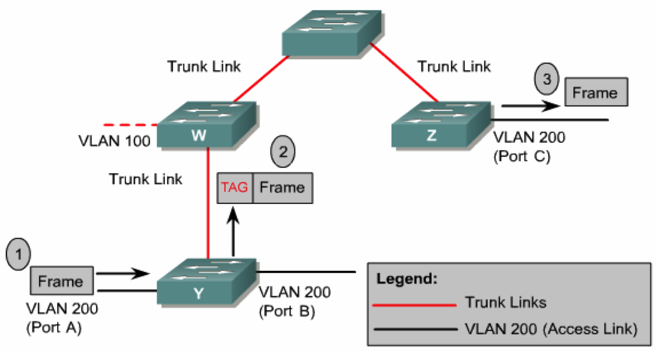
Frame Tagging
Each frame on trunk is tagged to identify VLAN it belongs to.
Trunking that uses frame tagging achieves faster delivery of frames and makes management easier.
Frame tagging adopted as standard by IEEE.

Slide 11
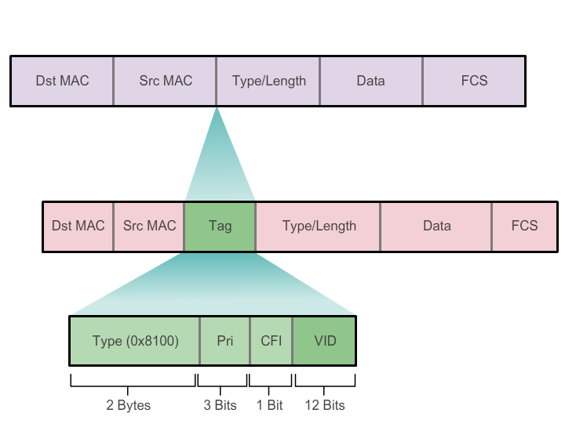
VLAN tag fields
Type - A 2-byte value called the tag protocol ID (TPID) value.
Ethernet - 0x8100.
User priority - A 3-bit value that supports level or service implementation.
Canonical Format Identifier (CFI) - A 1-bit identifier that enables Token Ring frames to be carried across Ethernet links.
VLAN ID (VID) - A 12-bit VLAN identification
up to 4096 VLAN IDs.
After the switch inserts the Type and tag control information fields, it recalculates the FCS values and inserts the new FCS into the frame.

Slide 12
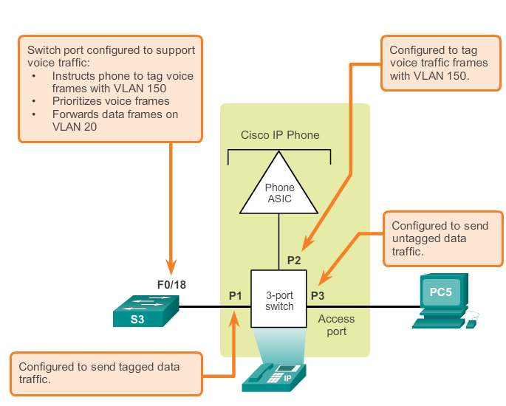
Voice VLAN tagging

Slide 13
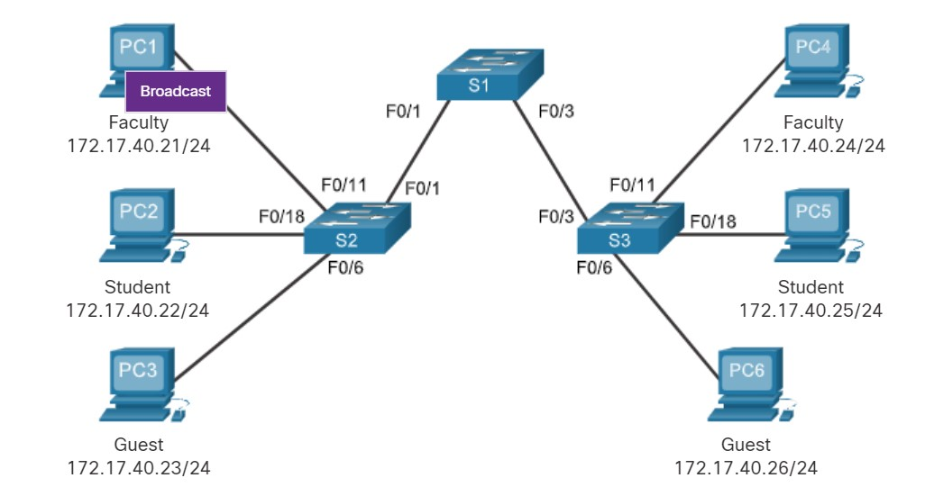
Quiz 1
Go to www.menti.com and use the code 1915 1067
In a switched network without VLAN, PC1 is sending a layer 2 broadcast, which of the following is correct?
(a). The broadcast frame will reach PC2 – PC6.
(b). The broadcast frame will only reach PC4.
(c). The broadcast frame will reach PC4, PC5 and PC6.
(d). None of the above is correct.

Slide 14
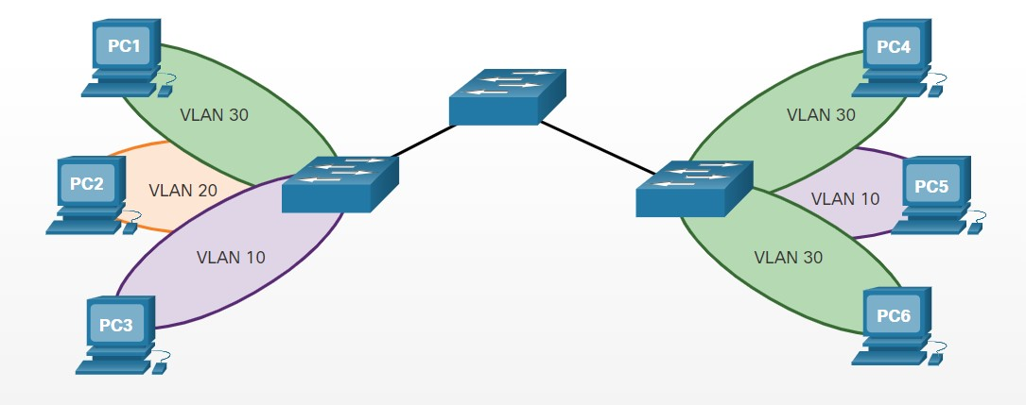
Quiz 2
In a switched network with 3 VLANs configured (VLAN10, VLAN20 and VLAN30), PC1 sends an ARP broadcast frame. Which of the following is correct regarding PC(s) which will receive the ARP broadcast frame?
(a). PC4
(b). PC4 and PC6
(c). PC4, PC5 and PC6
(d). None of the above
Go to www.menti.com and use the code 1915 1067

Slide 15
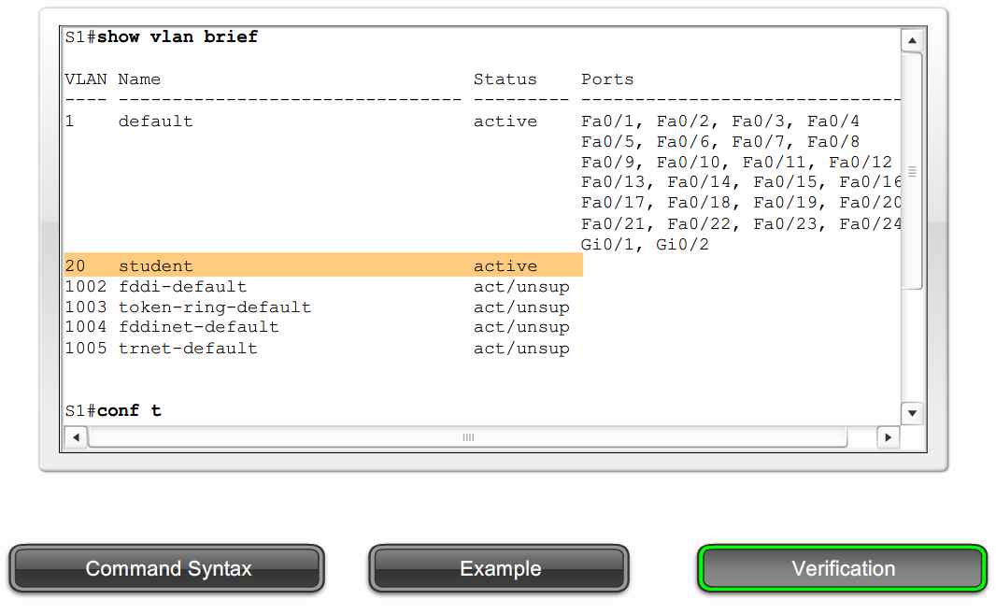
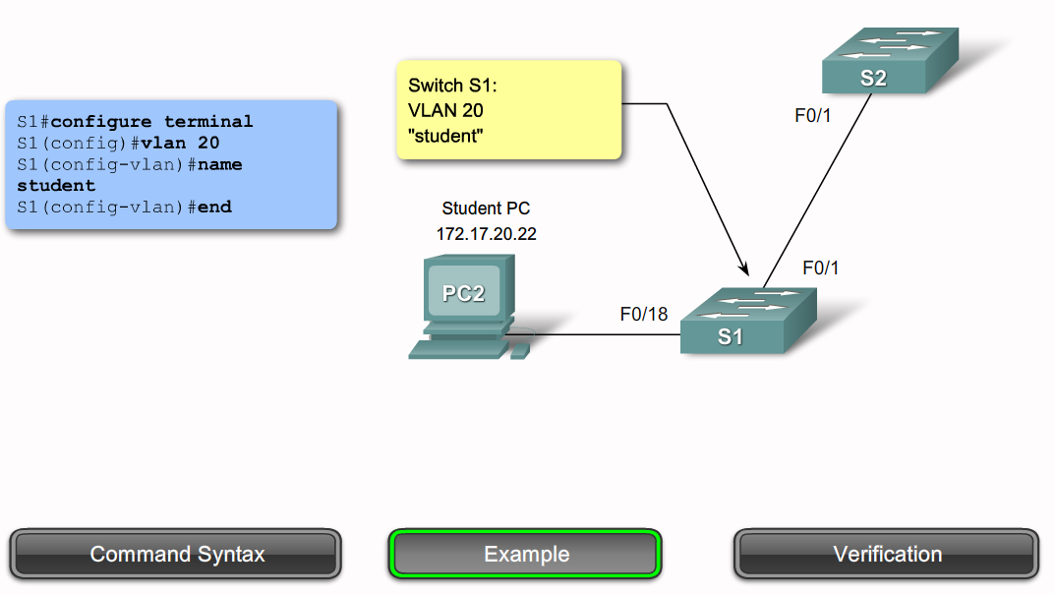
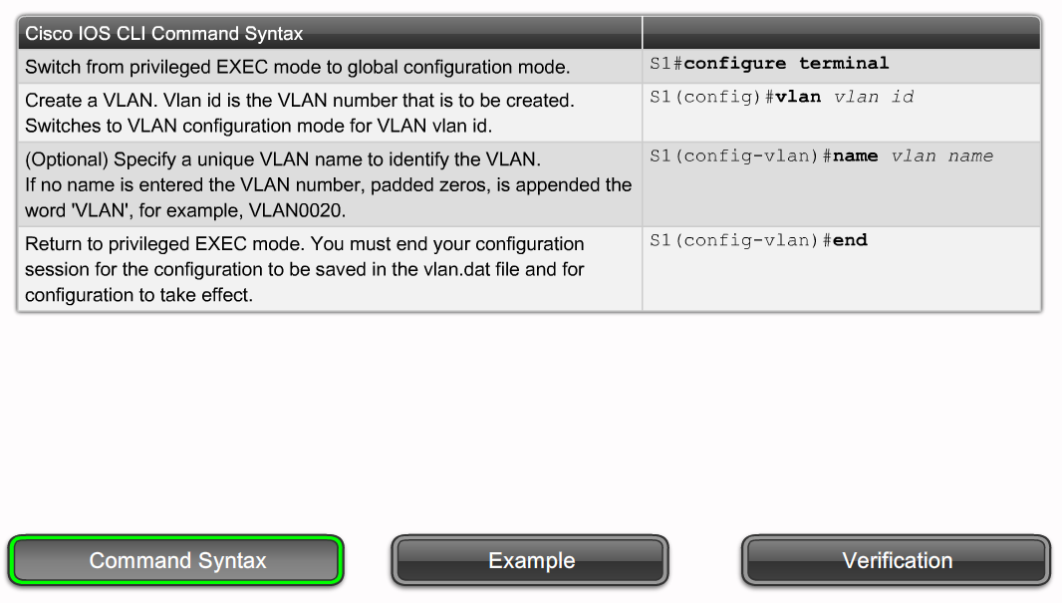
VLAN configuration

Slide 16
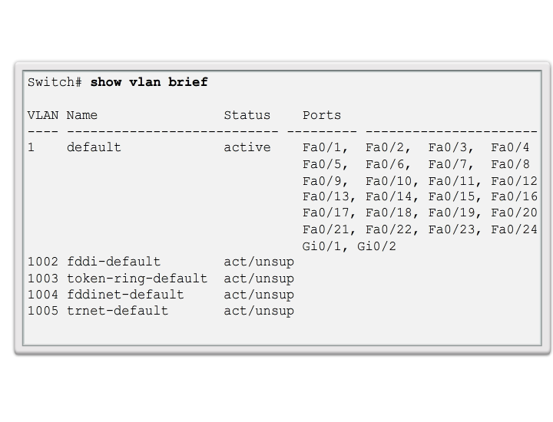
Normal range VLANs
Normal range VLANs are numbered between 1 and 1005.
IDs of 1 and 1002-1005 are automated created.
Extended range VLANs are numbered 1,006 to 4,094.

Slide 17
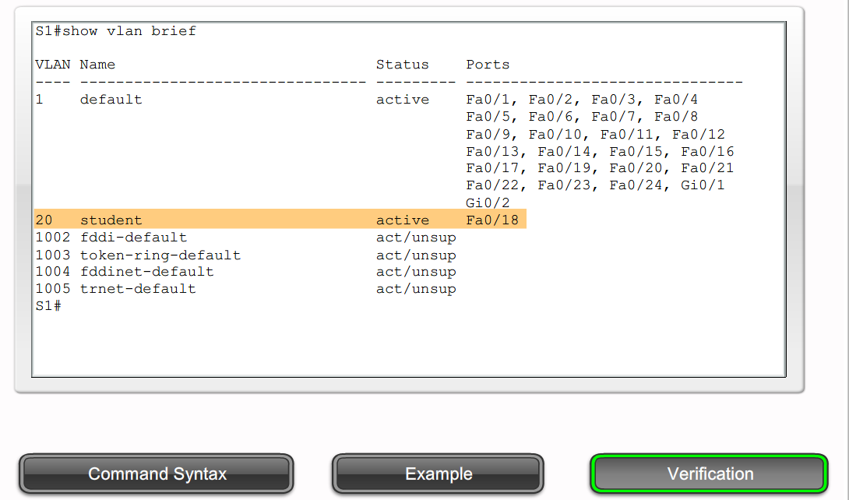
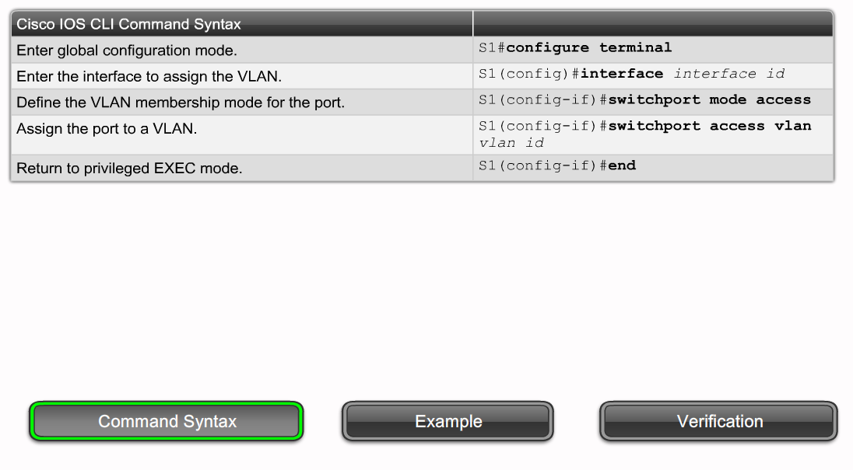
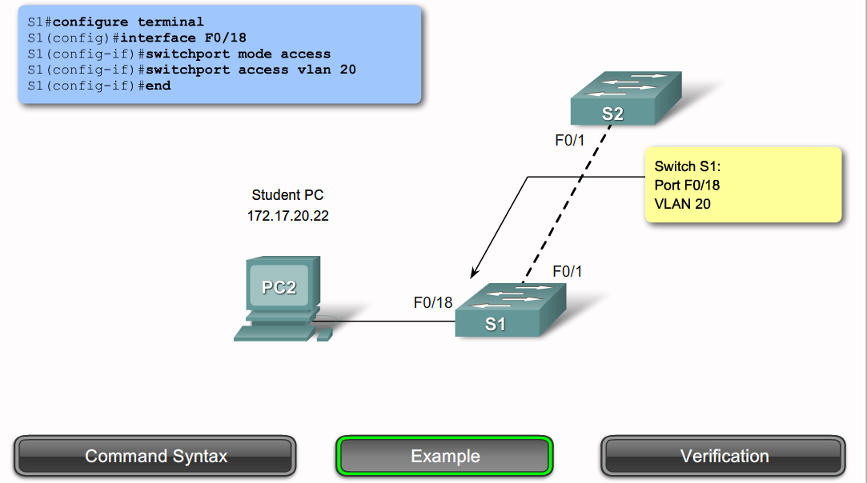
VLAN – assign a switch port

Slide 18
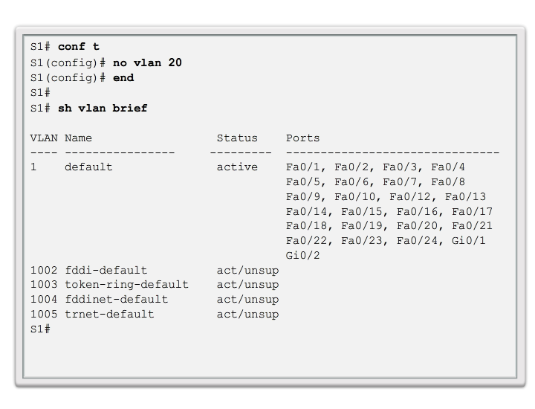
Delete a VLAN

Slide 19
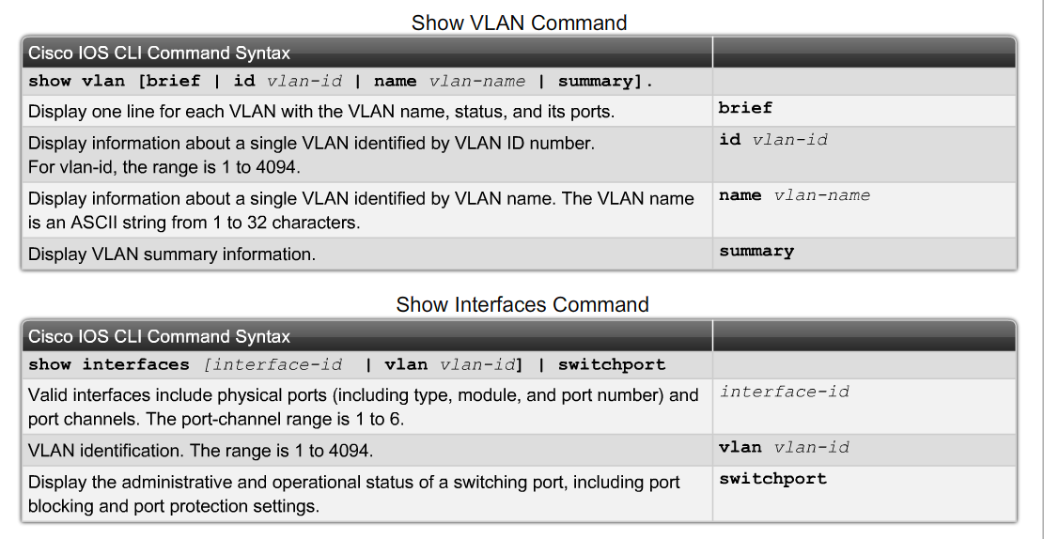
Verify VLANs and membership

Slide 20
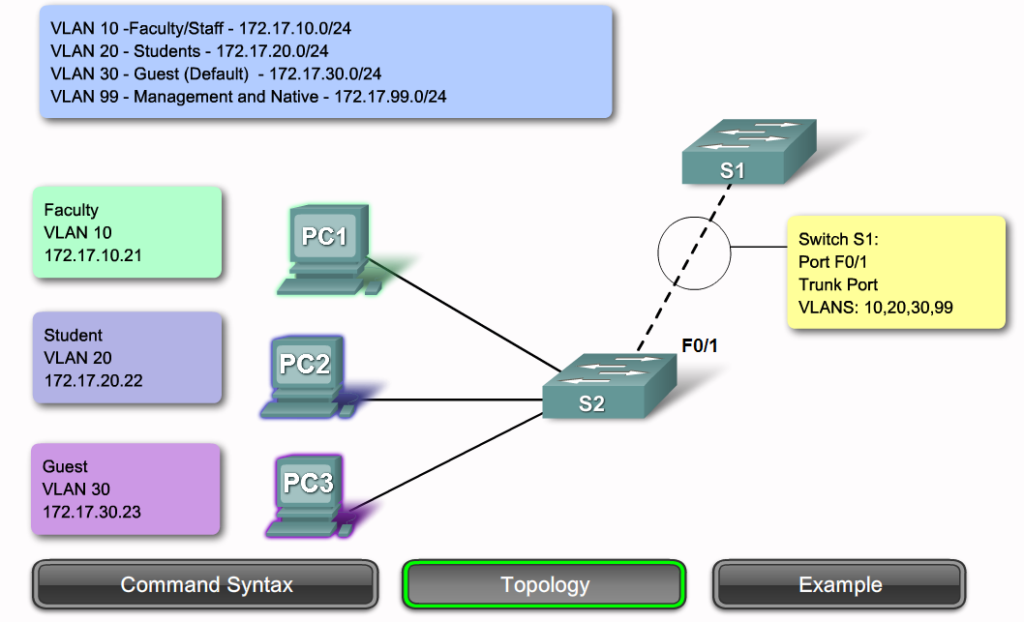
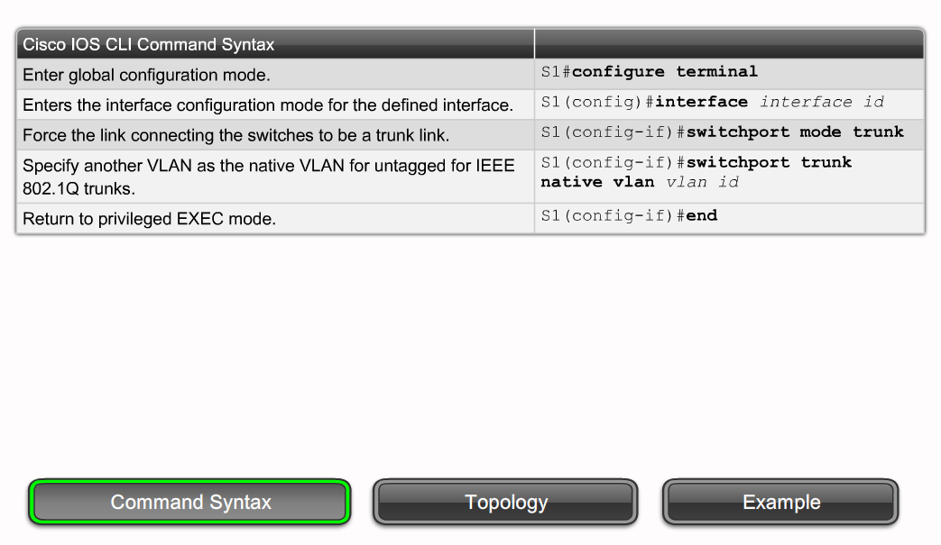
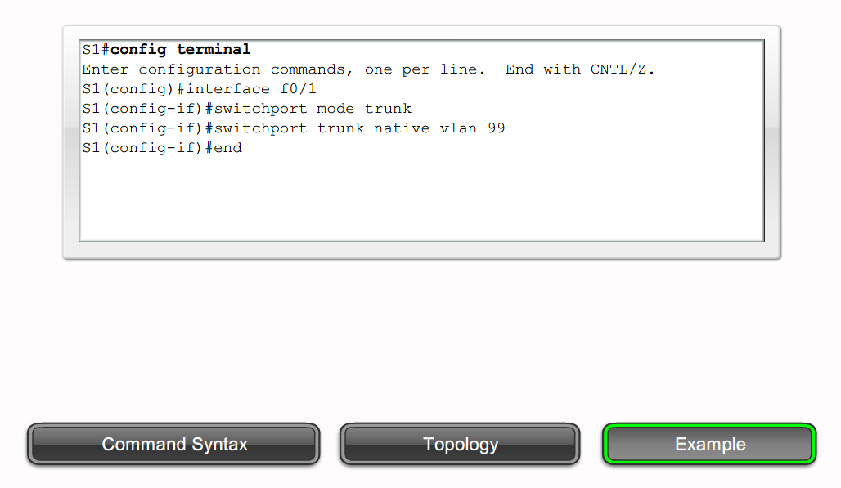
Trunk configuration

Slide 21
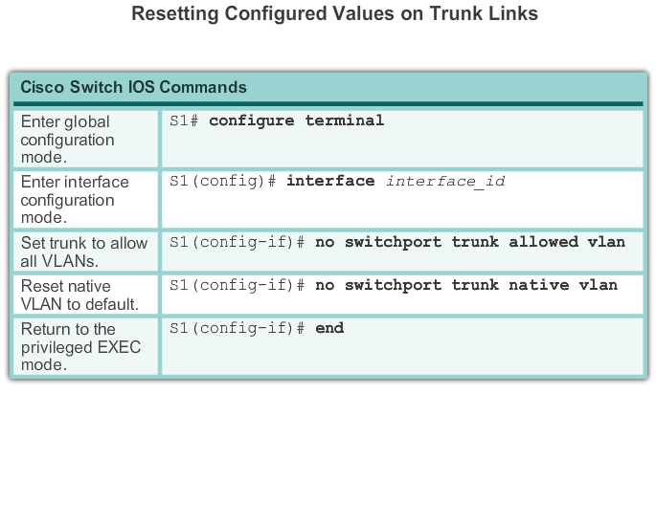
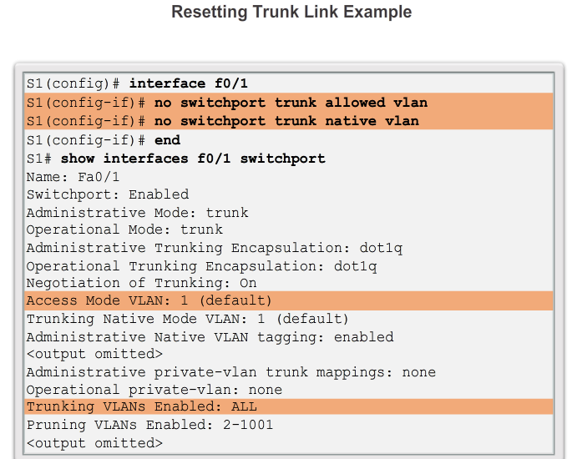
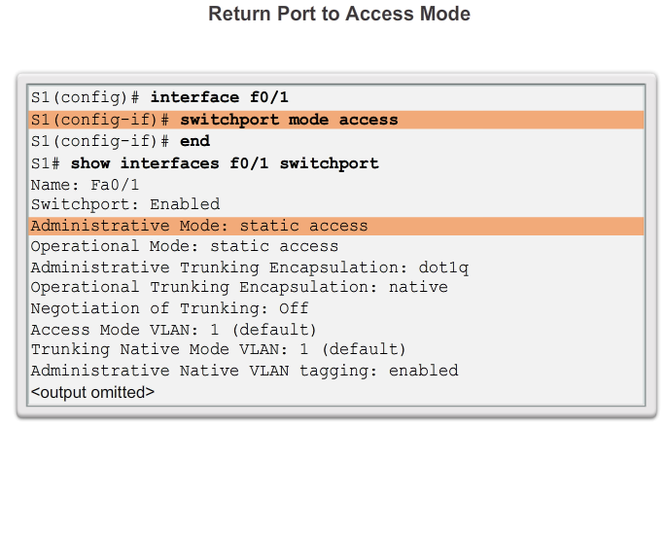
Resetting trunks

Slide 22
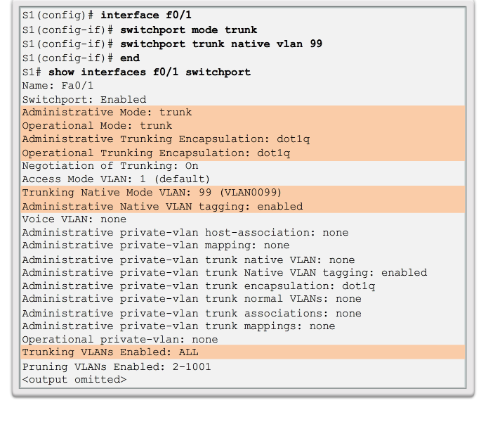
Verify trunk configuration

Slide 23
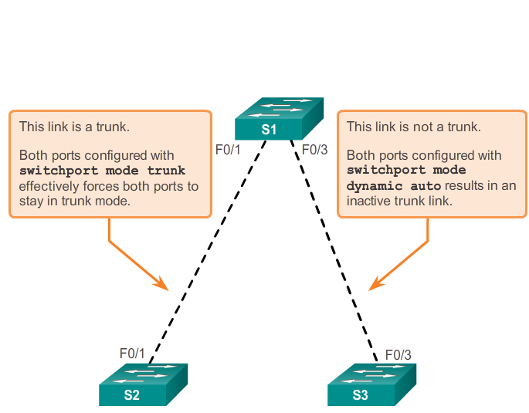
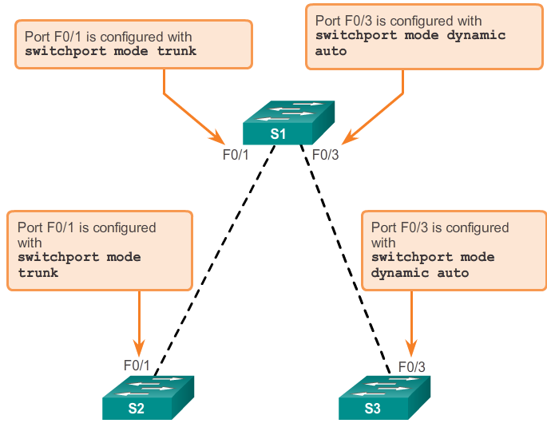
Dynamic Trunking Protocol (DTP)

Slide 24
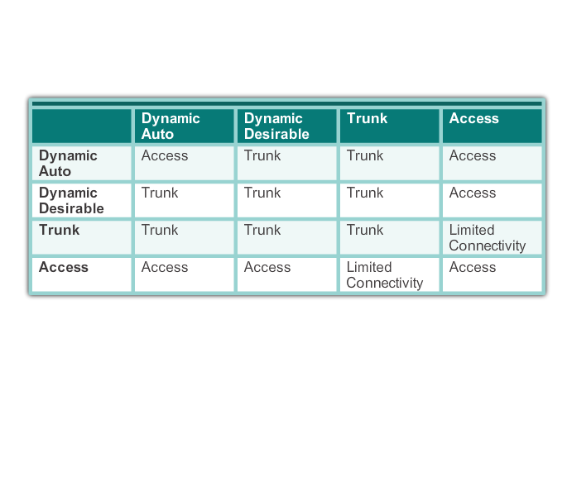
DTP modes

Slide 25
DTP modes
switchport mode access - permanent nontrunking mode and negotiates to convert the link into a nontrunk link. The interface becomes a nontrunk interface, regardless of whether the neighboring interface is a trunk interface.
switchport mode dynamic auto - able to convert the link to a trunk link. The interface becomes a trunk interface if the neighboring interface is set to trunk or desirable mode. It is the default switchport mode.
switchport mode dynamic desirable - actively attempt to convert the link to a trunk link. Interface becomes trunk if neighboring interface is trunk, desirable, or auto. It is the default switchport mode on older switches(2950 and 3550).
switchport mode trunk - permanent trunking mode, negotiates to convert neighboring link into trunk. Interface becomes trunk even if the neighboring interface is not trunk.
switchport nonegotiate - Prevents the interface from generating DTP frames. Can use this command only when the interface switchport mode is access or trunk. You must manually configure the neighboring interface as a trunk interface to establish a trunk link.

Slide 26
Troubleshoot VLANs
IP issues
Misconfigured clients
Missing VLANs
VLANs must be present on all transit switches and ports must be assigned to it
Misconfigured trunks/links
Check interface and trunk settings - show interfaces trunk

Slide 27
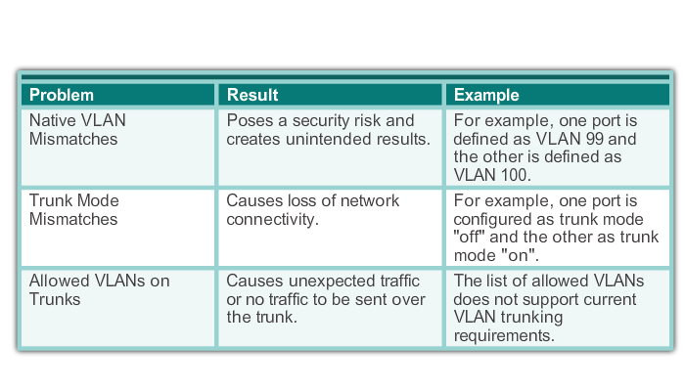
Trunk problems

Slide 28
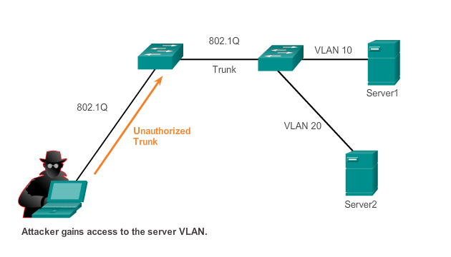
Switch attacks – switch spoofing
Notes:
A VLAN hopping attack. The attacker configure the host to spoof 802.1Q signalling and DTP signalling to trunk with the connecting switch.

Slide 29
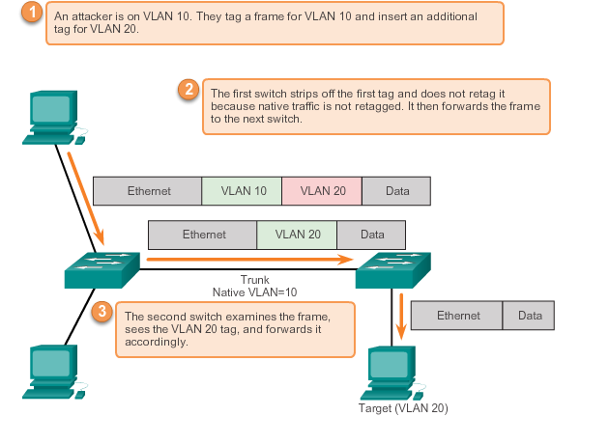
Double tagging attack

Slide 30
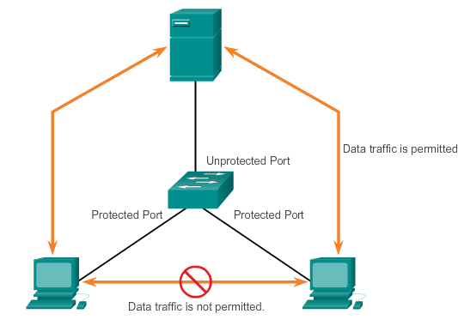
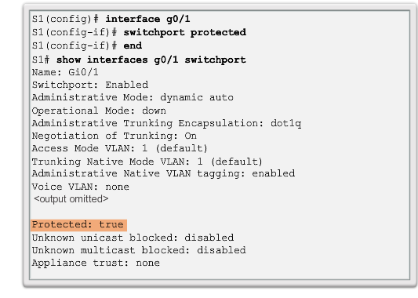
PVLAN edge
Notes:
Private VLAN – protected ports

Slide 31
Summary
VLAN segmentation
Definitions
Benefits
Types
VLAN environment
Trunks
Tagging
Implementation
Troubleshooting
VLAN security
Notes:
31

Slide 32
Activities and labs (CCNA2)
3.3.12 - VLAN configuration
3.6.1 - Implement VLANs and Trunking

Slide 33
Inter-VLAN Routing

Slide 34
Objectives
Inter-VLAN routing
enable
configure
troubleshoot

Slide 35
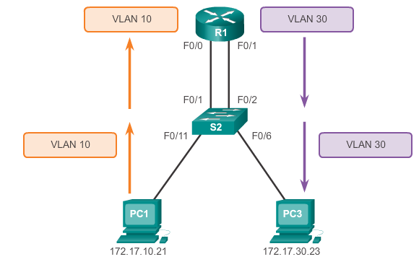
Inter-VLAN routing

Slide 36
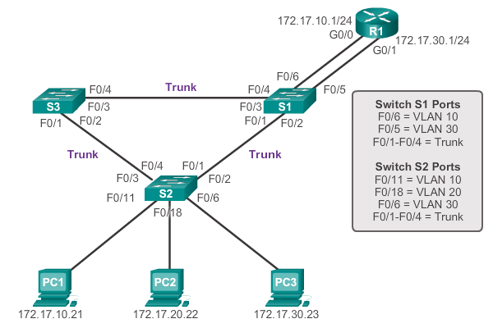
Legacy inter-VLAN routing

Slide 37
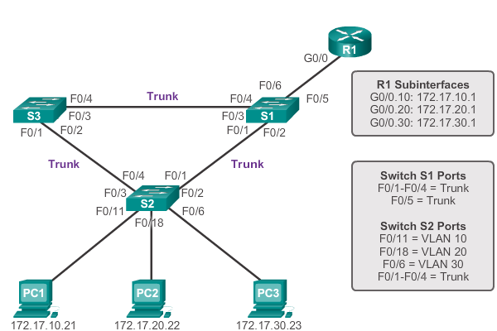
Router-on-a-stick

Slide 38
Switch-based inter-VLAN routing

Slide 39
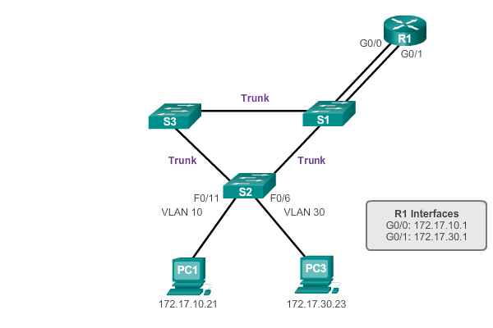
Configure legacy inter-VLAN routing

Slide 40
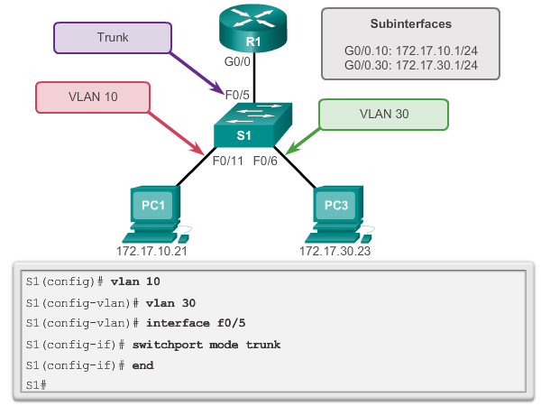
Router-on-a-stick – switch configuration

Slide 41
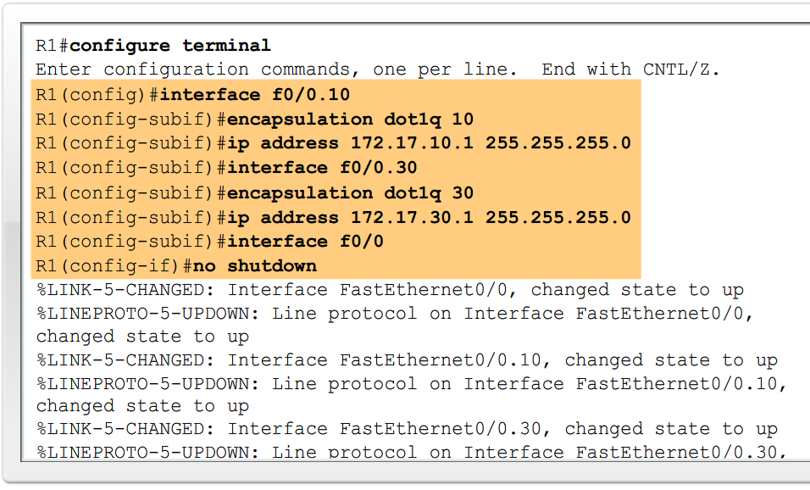
Router-on-a-stick – router configuration

Slide 42
Layer 3 switches
Routed port - pure Layer 3 interface similar to a physical interface on a Cisco IOS router.
Switch virtual interface (SVI) - virtual VLAN interface for inter-VLAN routing.

Slide 43
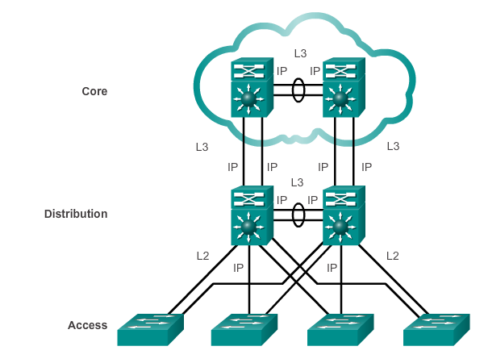
Switched architecture

Slide 44
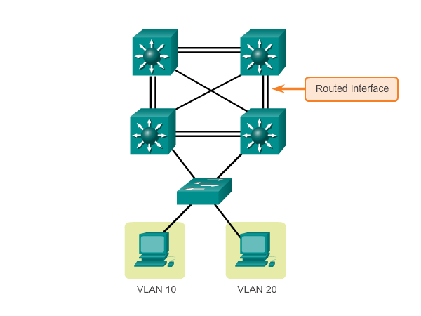
Inter-VLAN routing with routed ports

Slide 45
Switch configuration issues
VLANs - defined across all the switches, enabled on the trunk ports.
Ports - must be in the right VLANs.
SVIs - correct IP address or subnet mask.
SVI – up and match with the VLAN number.
Routing - enabled.
Each interface or network should be added to the routing protocol.
Hosts - correct IP address or subnet mask, default gateway associated with SVI or routed port.

Slide 46
Labs (CCNA2)
4.2.7 – Configure Router-on-a-stick interVLAN routing

